Slide 1
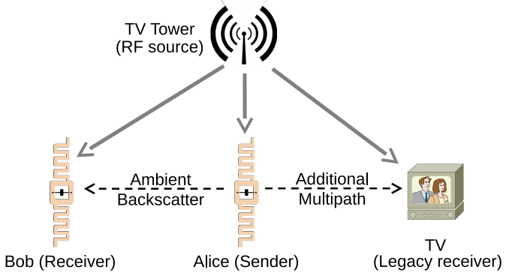
What is Ambient Backscatter Communication?
This type of communication will allow smart devices to communicate by using ambient Radio Frequency (RF) signals without using RF transmissions.

Slide 2
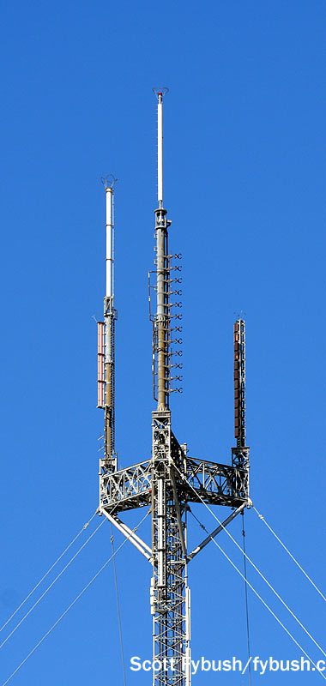
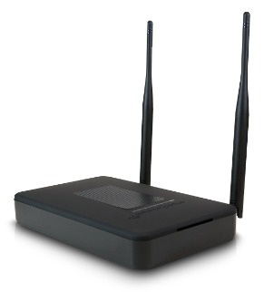
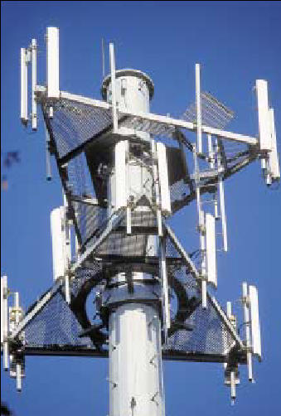
Types of Sources
TV towers
Cellular base stations
Wi-Fi Access Points

Slide 3

Advantages
Since Ambient Backscatter Communication Systems (ABCS) uses free RF signals such as Wi-Fi, there’s no need to adjust the frequency of the signal.
Also, ABCS doesn’t need a dedicated RF source since its already using Wi-Fi.

Slide 4
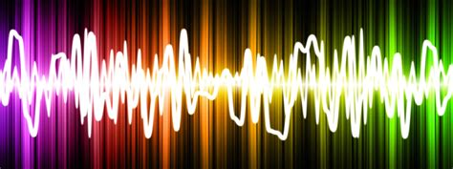

Disadvantages
Wi-Fi signals are dynamic and unpredictable, so ABCS communication can be unstable.
Also, the communication is not controllable, so its harder to execute.

